Slide 1
Data Structures
25. Minimum Spanning Tree (MST)

Slide 2
Spanning Trees
A spanning tree of a graph is just a subgraph that contains all the vertices and is a tree
Formal definition
Given a connected graph with |V| = n vertices
A spanning tree is defined a collection of n – 1 edges which connect all n vertices
The n vertices and n – 1 edges define a connected sub-graph
Graph
Spanning Tree

Slide 3
Spanning Trees
A spanning tree is not necessarily unique
Graph A
Some Spanning Trees from Graph A
or
or
or

Slide 4
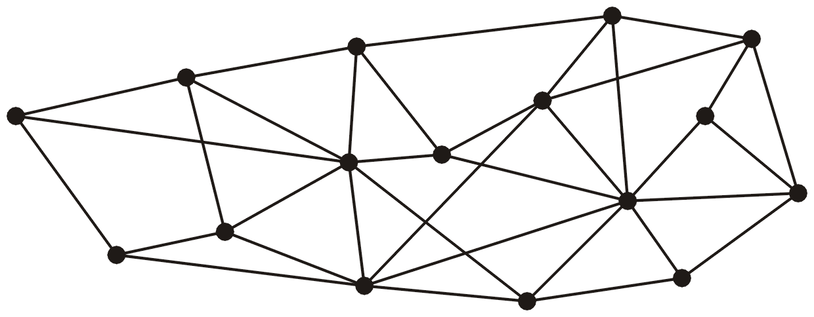
Spanning Trees – Example
This graph has 16 vertices and 35 edges

Slide 5
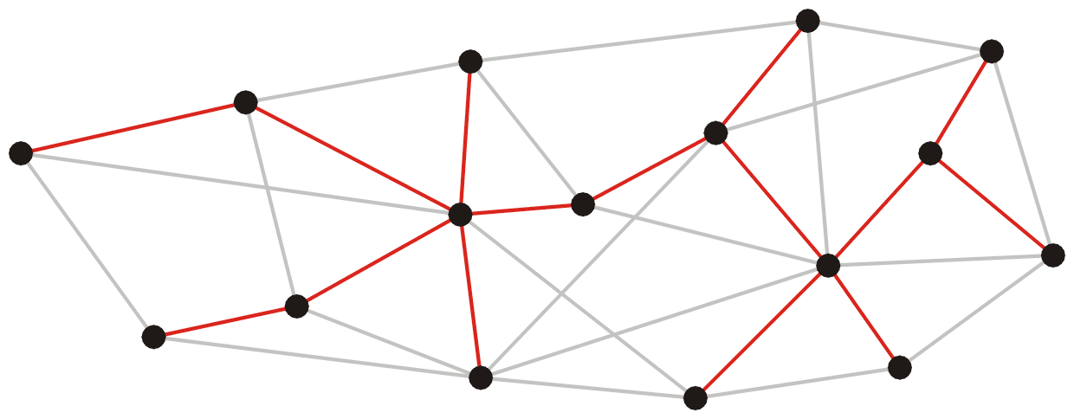
Spanning Trees – Example
These 15 edges form a minimum spanning tree

Slide 6
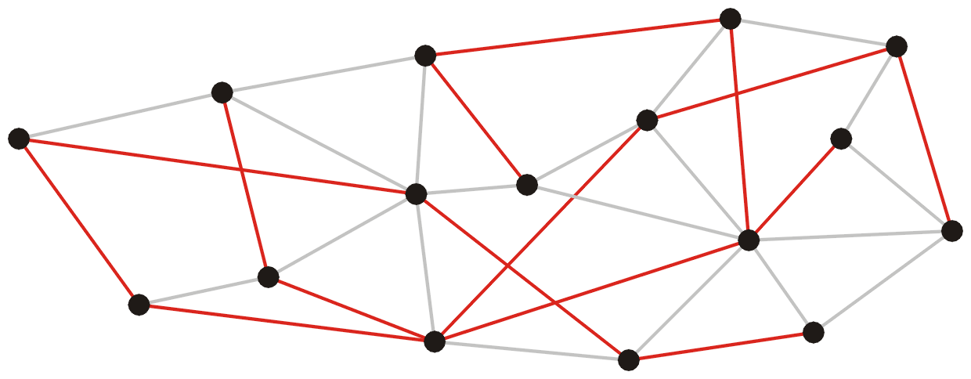
Spanning Trees – Example
As do these 15 edges

Slide 7
Spanning Trees – Example
Graph
All 16 of its Spanning Trees

Slide 8
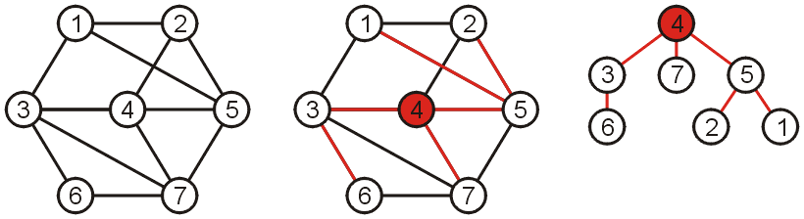
Spanning Trees
Why such a collection of |V|-1 edges is called a tree?
If any vertex is taken to be the root, we form a tree by treating the adjacent vertices as children, and so on...

Slide 9

Spanning Tree on Weighted Graphs
Weight of a spanning tree
Sum of the weights on all the edges which comprise the spanning tree
The weight of this spanning tree is 20

Slide 10
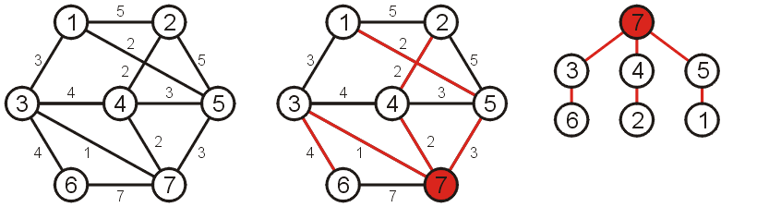
Minimum Spanning Tree (MST)
Spanning tree that minimizes the weight
Such a tree is termed a minimum spanning tree
The weight of this spanning tree is 14

Slide 11
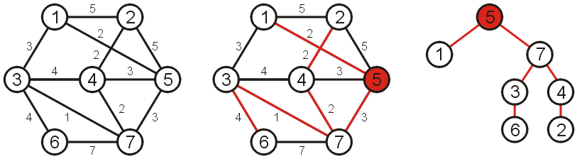
Minimum Spanning Tree (MST)
If a different vertex is used as the root
A different tree is obtained
However, this is simply the result of one or more rotations

Slide 12
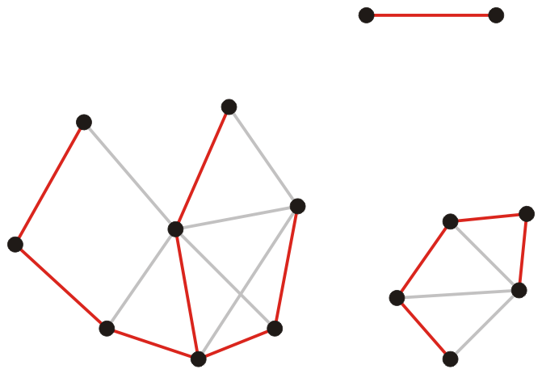
Spanning Forest
Suppose that a graph is composed of N connected sub-graphs
A spanning forest is a collection of N spanning trees
One for each connected sub-graph
A minimum spanning forest
A collection of N minimum spanning trees
One for each connected vertex-induced sub-graph

Slide 13
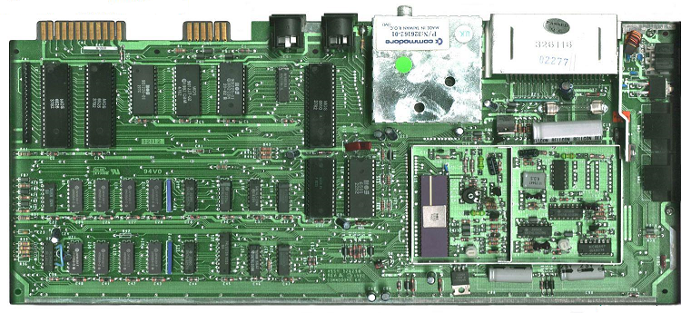

Applications
Consider supplying power to
All circuit elements on a board
A number of loads within a building
A minimum spanning tree will give the lowest-cost solution

Slide 14
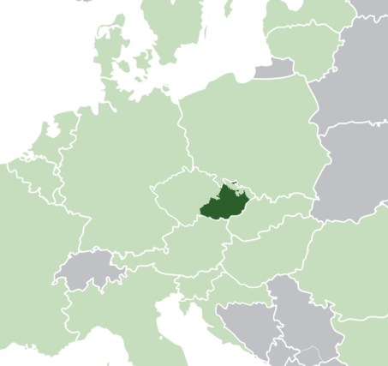
Application
First application of a minimum spanning tree algorithm was by the Czech mathematician Otakar Borůvka
Designed electricity grid in Morovia in 1926

Slide 15
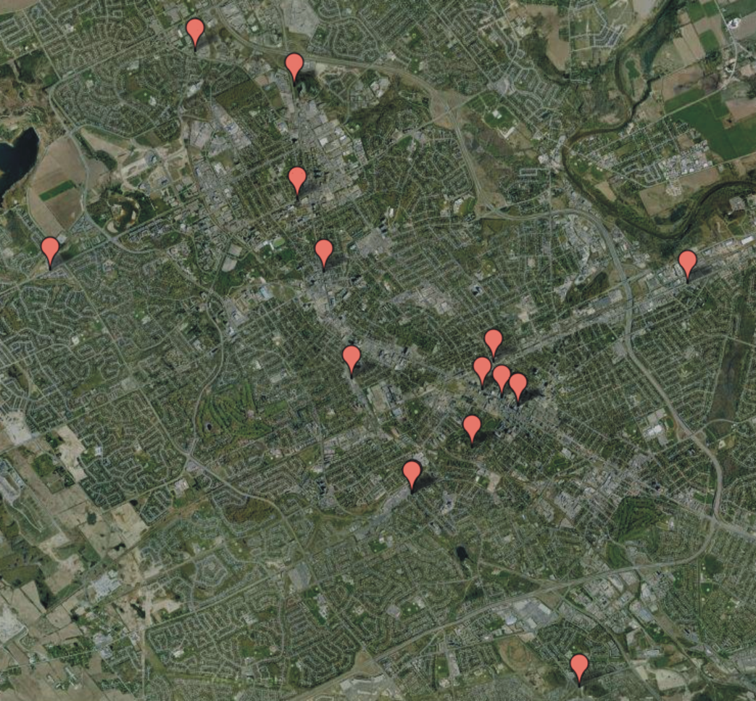
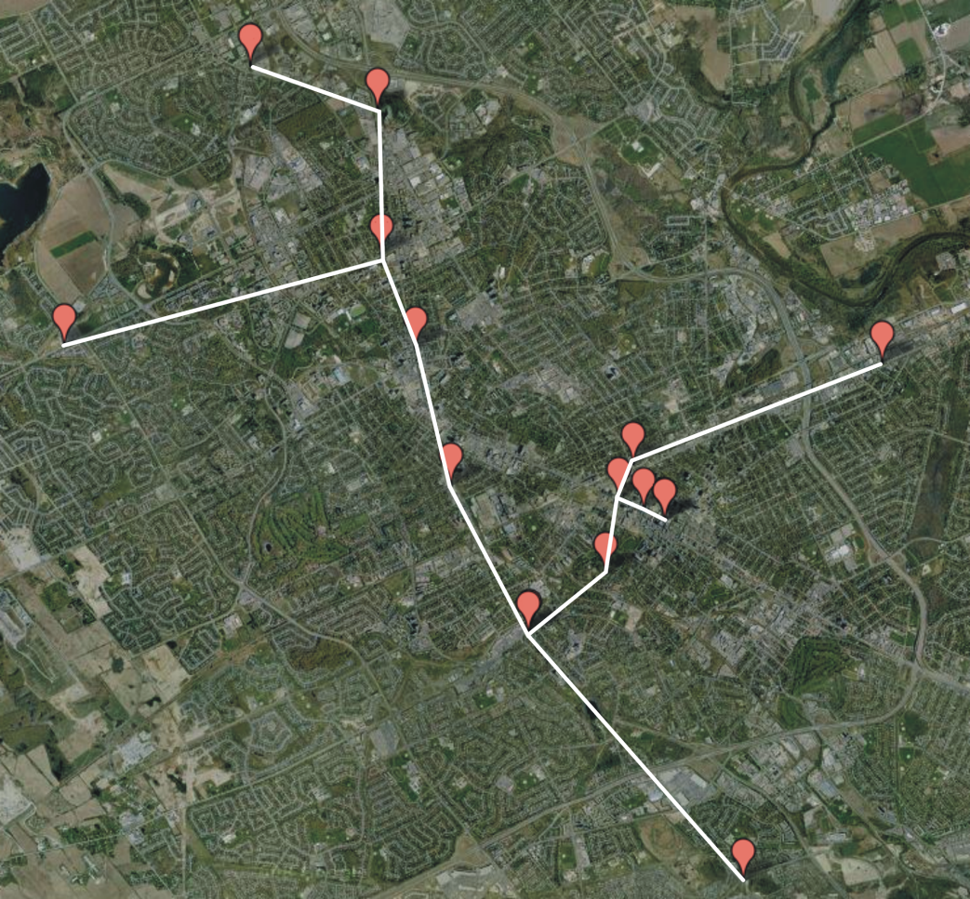
Application
Consider attempting to find the best means of connecting a number of Local Area Networks (LANs)
Minimize the number of bridges
Costs not strictly dependent on distances

Slide 16
Algorithms For Obtaining MST
Kruskal's Algorithm
Prim's Algorithm
Boruvka's Algorithm

Slide 17
Prim’s Algorithm

Slide 18
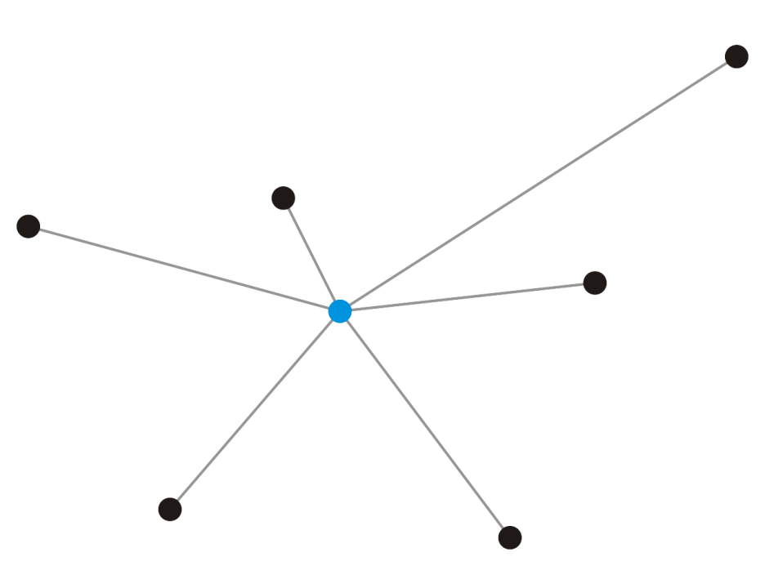
Idea
Suppose we take a vertex v₁
It forms a minimum spanning tree on one vertex
v₁

Slide 19
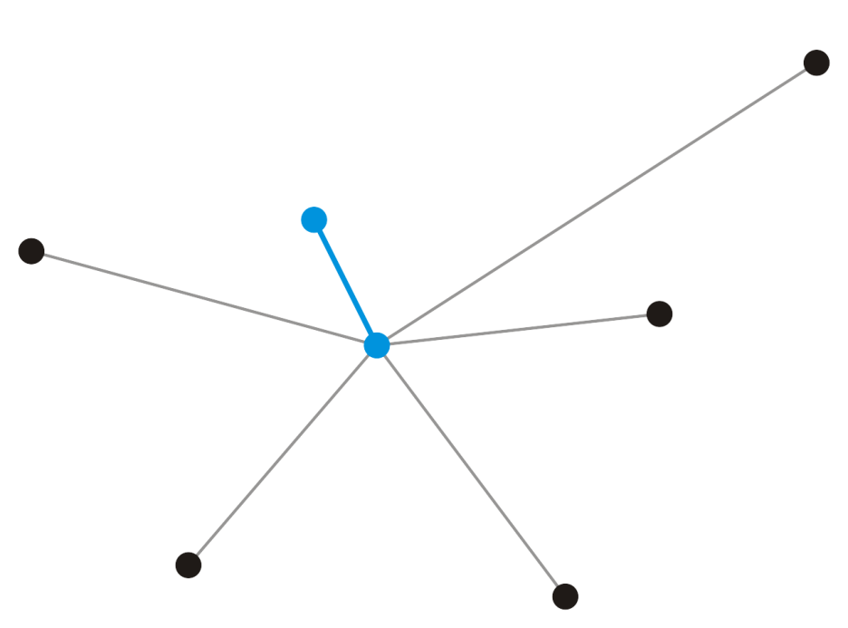
Idea
Add that adjacent vertex v₂ that has a connecting edge e₁ of minimum weight
This forms a minimum spanning tree on two vertices
e₁ must be in any minimum spanning tree containing the vertices v₁ and v₂
v₂
e₁
v₁

Slide 20
Prim’s Algorithm
Start with an arbitrary vertex to form a minimum spanning tree on one vertex
At each step, add a vertex v not yet in the minimum spanning tree
Through an edge with least weight that connects v to the existing minimum spanning sub-tree
Continue until we have n – 1 edges and n vertices

Slide 21
Prim’s Algorithm – Pseudocode
MST-Prim(G, w, r) { // w is the weight matrix of edges, r is root
Q = V[G]; // Insert graph vertices to a Priority Queue
for each u ∈ Q // Set distance of all vertices as ∞
key[u] = ∞;
key[r] = 0; // Distance of root is set to 0
p[r] = NULL; // Parent of root is NULL
while (Q not empty) {
u = ExtractMin(Q); // Get the vertex u with min key[u]
for each v ∈ Adj[u] { // Adj is the adjacency list
if (v ∈ Q and w(u,v) < key[v]) {
p[v] = u;
key[v] = w(u,v); // weight of an edge (u,v)
}
}
}
}

Slide 22
Prim’s Algorithm – Data Structure
Associate with each vertex two items of data
The minimum distance to the partially constructed tree
For a given vertex v, key[v] represent minimum distance
Pointer to the vertex that will form the parent node in resulting tree
For a given vertex v, p[v] represent parent node
Initialization
Set the distance of all vertices as ∞, e.g., for all u ∈ G, key[u]= ∞
Set all vertices to being unvisited
Add vertices to the Queue
Select a root node and set its distance as 0, i.e., key[r] = 0
Set the parent pointer of root to NULL, i.e., p[r] = NULL

Slide 23
Prim’s Algorithm – Example
MST-Prim(G, w, r)
Q = V[G];
for each u ∈ Q
key[u] = ∞;
key[r] = 0;
p[r] = NULL;
while (Q not empty)
u = ExtractMin(Q);
for each v ∈ Adj[u]
if (v ∈ Q and w(u,v) < key[v])
p[v] = u;
key[v] = w(u,v);
6
4
9
5
14
10
2
15
3
8
Run on example graph

Slide 24
Prim’s Algorithm – Example
∞
MST-Prim(G, w, r)
Q = V[G];
for each u ∈ Q
key[u] = ∞;
key[r] = 0;
p[r] = NULL;
while (Q not empty)
u = ExtractMin(Q);
for each v ∈ Adj[u]
if (v ∈ Q and w(u,v) < key[v])
p[v] = u;
key[v] = w(u,v);
6
4
9
∞
∞
∞
5
14
10
2
15
∞
∞
∞
3
∞
8
Run on example graph

Slide 25
Prim’s Algorithm – Example
∞
MST-Prim(G, w, r)
Q = V[G];
for each u ∈ Q
key[u] = ∞;
key[r] = 0;
p[r] = NULL;
while (Q not empty)
u = ExtractMin(Q);
for each v ∈ Adj[u]
if (v ∈ Q and w(u,v) < key[v])
p[v] = u;
key[v] = w(u,v);
6
4
9
∞
∞
∞
5
14
10
2
15
r
0
∞
∞
3
∞
8
Pick a start vertex r

Slide 26
Prim’s Algorithm – Example
∞
MST-Prim(G, w, r)
Q = V[G];
for each u ∈ Q
key[u] = ∞;
key[r] = 0;
p[r] = NULL;
while (Q not empty)
u = ExtractMin(Q);
for each v ∈ Adj[u]
if (v ∈ Q and w(u,v) < key[v])
p[v] = u;
key[v] = w(u,v);
6
4
9
∞
∞
∞
5
14
10
2
15
u
0
∞
∞
3
∞
8
Black vertices have been removed from Q

Slide 27
Prim’s Algorithm – Example
∞
MST-Prim(G, w, r)
Q = V[G];
for each u ∈ Q
key[u] = ∞;
key[r] = 0;
p[r] = NULL;
while (Q not empty)
u = ExtractMin(Q);
for each v ∈ Adj[u]
if (v ∈ Q and w(u,v) < key[v])
p[v] = u;
key[v] = w(u,v);
6
4
9
∞
∞
∞
5
14
10
2
15
u
0
∞
∞
3
3
8
Black arrows indicate parent pointers

Slide 28
Prim’s Algorithm – Example
∞
MST-Prim(G, w, r)
Q = V[G];
for each u ∈ Q
key[u] = ∞;
key[r] = 0;
p[r] = NULL;
while (Q not empty)
u = ExtractMin(Q);
for each v ∈ Adj[u]
if (v ∈ Q and w(u,v) < key[v])
p[v] = u;
key[v] = w(u,v);
6
4
9
14
∞
∞
5
14
10
2
15
u
0
∞
∞
3
3
8

Slide 29
Prim’s Algorithm – Example
∞
MST-Prim(G, w, r)
Q = V[G];
for each u ∈ Q
key[u] = ∞;
key[r] = 0;
p[r] = NULL;
while (Q not empty)
u = ExtractMin(Q);
for each v ∈ Adj[u]
if (v ∈ Q and w(u,v) < key[v])
p[v] = u;
key[v] = w(u,v);
6
4
9
14
∞
∞
5
14
10
2
15
0
∞
∞
3
3
8
u

Slide 30
Prim’s Algorithm – Example
∞
MST-Prim(G, w, r)
Q = V[G];
for each u ∈ Q
key[u] = ∞;
key[r] = 0;
p[r] = NULL;
while (Q not empty)
u = ExtractMin(Q);
for each v ∈ Adj[u]
if (v ∈ Q and w(u,v) < key[v])
p[v] = u;
key[v] = w(u,v);
6
4
9
14
∞
∞
5
14
10
2
15
0
8
∞
3
3
8
u

Slide 31
Prim’s Algorithm – Example
∞
MST-Prim(G, w, r)
Q = V[G];
for each u ∈ Q
key[u] = ∞;
key[r] = 0;
p[r] = NULL;
while (Q not empty)
u = ExtractMin(Q);
for each v ∈ Adj[u]
if (v ∈ Q and w(u,v) < key[v])
p[v] = u;
key[v] = w(u,v);
6
4
9
10
∞
∞
5
14
10
2
15
0
8
∞
3
3
8
u

Slide 32
Prim’s Algorithm – Example
∞
MST-Prim(G, w, r)
Q = V[G];
for each u ∈ Q
key[u] = ∞;
key[r] = 0;
p[r] = NULL;
while (Q not empty)
u = ExtractMin(Q);
for each v ∈ Adj[u]
if (v ∈ Q and w(u,v) < key[v])
p[v] = u;
key[v] = w(u,v);
6
4
9
10
∞
∞
5
14
10
2
15
0
8
∞
3
3
8
u

Slide 33
Prim’s Algorithm – Example
∞
MST-Prim(G, w, r)
Q = V[G];
for each u ∈ Q
key[u] = ∞;
key[r] = 0;
p[r] = NULL;
while (Q not empty)
u = ExtractMin(Q);
for each v ∈ Adj[u]
if (v ∈ Q and w(u,v) < key[v])
p[v] = u;
key[v] = w(u,v);
6
4
9
10
2
∞
5
14
10
2
15
0
8
∞
3
3
8
u

Slide 34
Prim’s Algorithm – Example
∞
MST-Prim(G, w, r)
Q = V[G];
for each u ∈ Q
key[u] = ∞;
key[r] = 0;
p[r] = NULL;
while (Q not empty)
u = ExtractMin(Q);
for each v ∈ Adj[u]
if (v ∈ Q and w(u,v) < key[v])
p[v] = u;
key[v] = w(u,v);
6
4
9
10
2
∞
5
14
10
2
15
0
8
15
3
3
8
u

Slide 35
Prim’s Algorithm – Example
∞
u
MST-Prim(G, w, r)
Q = V[G];
for each u ∈ Q
key[u] = ∞;
key[r] = 0;
p[r] = NULL;
while (Q not empty)
u = ExtractMin(Q);
for each v ∈ Adj[u]
if (v ∈ Q and w(u,v) < key[v])
p[v] = u;
key[v] = w(u,v);
6
4
9
10
2
∞
5
14
10
2
15
0
8
15
3
3
8

Slide 36
Prim’s Algorithm – Example
4
u
MST-Prim(G, w, r)
Q = V[G];
for each u ∈ Q
key[u] = ∞;
key[r] = 0;
p[r] = NULL;
while (Q not empty)
u = ExtractMin(Q);
for each v ∈ Adj[u]
if (v ∈ Q and w(u,v) < key[v])
p[v] = u;
key[v] = w(u,v);
6
4
9
10
2
∞
5
14
10
2
15
0
8
15
3
3
8

Slide 37
Prim’s Algorithm – Example
4
u
MST-Prim(G, w, r)
Q = V[G];
for each u ∈ Q
key[u] = ∞;
key[r] = 0;
p[r] = NULL;
while (Q not empty)
u = ExtractMin(Q);
for each v ∈ Adj[u]
if (v ∈ Q and w(u,v) < key[v])
p[v] = u;
key[v] = w(u,v);
6
4
9
5
2
∞
5
14
10
2
15
0
8
15
3
3
8

Slide 38
Prim’s Algorithm – Example
4
u
MST-Prim(G, w, r)
Q = V[G];
for each u ∈ Q
key[u] = ∞;
key[r] = 0;
p[r] = NULL;
while (Q not empty)
u = ExtractMin(Q);
for each v ∈ Adj[u]
if (v ∈ Q and w(u,v) < key[v])
p[v] = u;
key[v] = w(u,v);
6
4
9
5
2
9
5
14
10
2
15
0
8
15
3
3
8

Slide 39
Prim’s Algorithm – Example
u
4
MST-Prim(G, w, r)
Q = V[G];
for each u ∈ Q
key[u] = ∞;
key[r] = 0;
p[r] = NULL;
while (Q not empty)
u = ExtractMin(Q);
for each v ∈ Adj[u]
if (v ∈ Q and w(u,v) < key[v])
p[v] = u;
key[v] = w(u,v);
6
4
9
5
2
9
5
14
10
2
15
0
8
15
3
3
8

Slide 40
Prim’s Algorithm – Example
u
4
MST-Prim(G, w, r)
Q = V[G];
for each u ∈ Q
key[u] = ∞;
key[r] = 0;
p[r] = NULL;
while (Q not empty)
u = ExtractMin(Q);
for each v ∈ Adj[u]
if (v ∈ Q and w(u,v) < key[v])
p[v] = u;
key[v] = w(u,v);
6
4
9
5
2
9
5
14
10
2
15
0
8
15
3
3
8

Slide 41
Prim’s Algorithm – Example
u
4
MST-Prim(G, w, r)
Q = V[G];
for each u ∈ Q
key[u] = ∞;
key[r] = 0;
p[r] = NULL;
while (Q not empty)
u = ExtractMin(Q);
for each v ∈ Adj[u]
if (v ∈ Q and w(u,v) < key[v])
p[v] = u;
key[v] = w(u,v);
6
4
9
5
2
9
5
14
10
2
15
0
8
15
3
3
8

Slide 42
Prim’s Algorithm – Example
4
MST-Prim(G, w, r)
Q = V[G];
for each u ∈ Q
key[u] = ∞;
key[r] = 0;
p[r] = NULL;
while (Q not empty)
u = ExtractMin(Q);
for each v ∈ Adj[u]
if (v ∈ Q and w(u,v) < key[v])
p[v] = u;
key[v] = w(u,v);
6
4
9
5
2
9
5
14
10
2
15
0
8
15
3
3
8
u

Slide 43
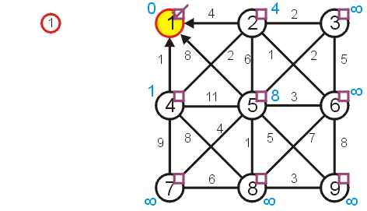
Prim’s Algorithm – Example
Is vertex removed from Queue?
w(6,3) = 5
p[4] = 1
Key[4] = 1

Slide 44
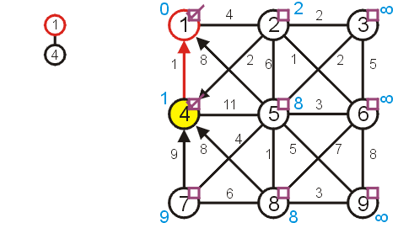
Prim’s Algorithm – Example

Slide 45
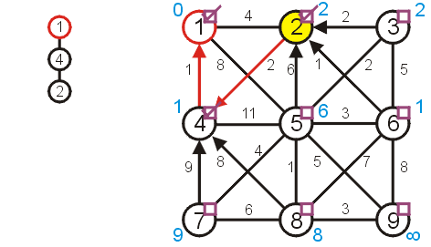
Prim’s Algorithm – Example

Slide 46
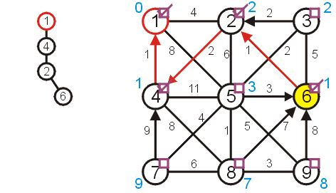
Prim’s Algorithm – Example

Slide 47
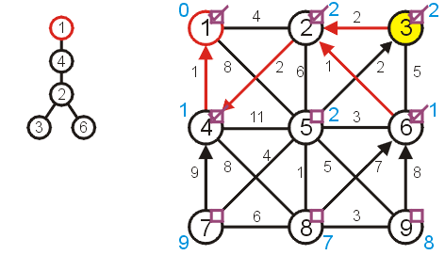
Prim’s Algorithm – Example

Slide 48
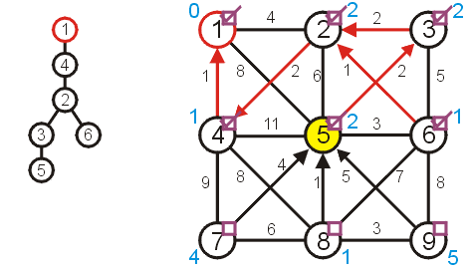
Prim’s Algorithm – Example

Slide 49
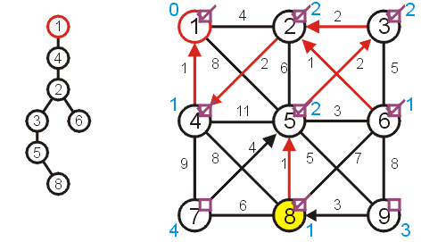
Prim’s Algorithm – Example

Slide 50
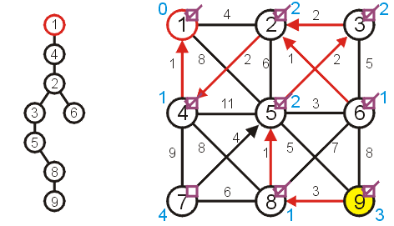
Prim’s Algorithm – Example

Slide 51
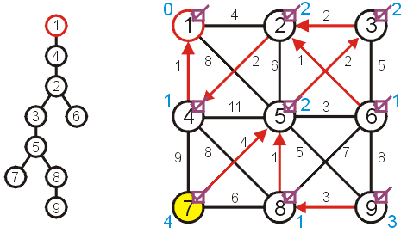
Prim’s Algorithm – Example

Slide 52
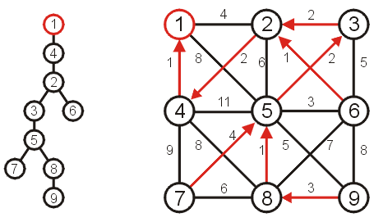
Prim’s Algorithm – Example

Slide 53
Kruskal’s Algorithm vs Prim’s Algorithm
In prim’s algorithm, graph must be connected
Kruskal’s algorithm can function on disconnected graphs too
Prim's algorithm is significantly faster for dense graphs with more number of edges than vertices
Kruskal's algorithm runs faster in the case of sparse graphs

Slide 54
Any Question So Far?

